Slide 1

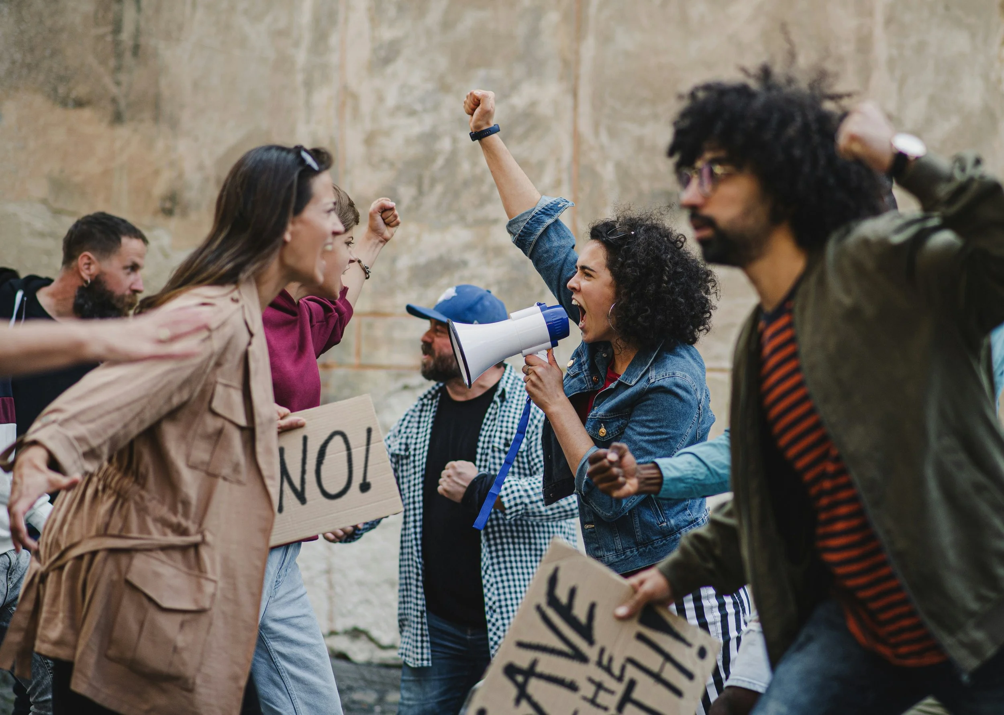
Traditional Activism:
Protests
Civil disobedience
Public Demonstrations
Problem: Increasingly polarized society
Notes:
Political satire is more suitable for the digital age than traditional activism
Traditional forms of activism: protest, civil disobedience and public demonstrations
…. Protests abundant but political divisions deepen
Reactance theory: When people feel directly persuaded or pressured, they instinctively resist. Overt attempts to change minds actually threaten our sense of autonomy, resist message and potentially strengthen our original positions. Traditional activism, often triggers exactly this defensive response.

Slide 2
Traditional Activism:
Protests
Civil disobedience
Public Demonstrations
Problem: Increasingly polarized society
Notes:
Political satire is more suitable for the digital age than traditional activism
Traditional forms of activism: protest, civil disobedience and public demonstrations rely on direct persuasion of an opposition
…. Form of activism abundant but political divisions deepen
Reactance theory: When people feel directly persuaded or pressured, they instinctively resist. Overt attempts to change minds actually threaten our sense of autonomy, resist message and potentially strengthen our original positions. Traditional activism often triggers exactly this defensive response.

Slide 3

Political Satire as a solution
Direct Approach
Indirect Approach
Resistance
Engagement
Notes:
Political satire indirect approach
Humor irony and exaggeration
Embedding critique in entertainment.
Research paper explores the idea that political satire circumvents defensive barriers people put up due to reactance. Causing people to engage rather than resist

Slide 4
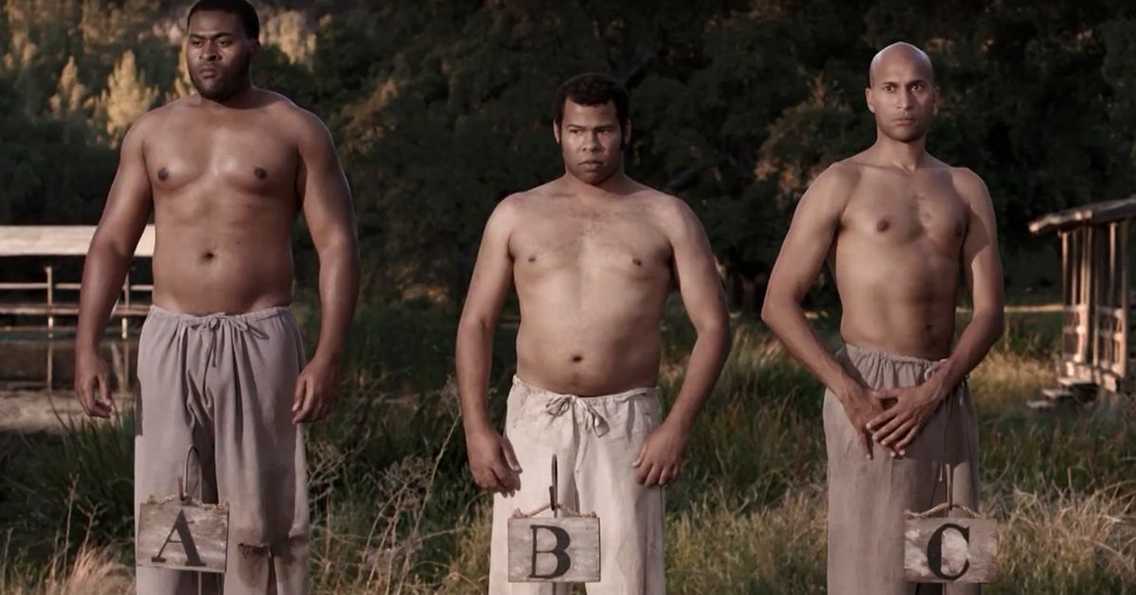
Political Satire: Key and Peele
Comedy Duo: Key and Peele
Case Study: Auction Block
1848 slave auction setting
Enslaved Men: defiance -> desperate competition
Notes:
Comedy Duo Key and Peele have mastered this approach
set at an 1848 slave auction, the sketch follows enslaved men who initially resist being sold, but then desperately compete to be purchased when they see others being chosen.

Slide 5
Political Satire: Key and Peele
How it works:
Uses:
Irony
Absurdity
Effects:
Makes difficult history approachable
Audiences confront moral contradiction themselves
No direct lecturing
Notes:
Through Absurdity and Irony, Key and peele make the dehumanizing nature of slave auctions more approachable to a broader audience
Rather than lecturing about historical injustice, viewers confront the system’s moral contradictions themselves

Slide 6
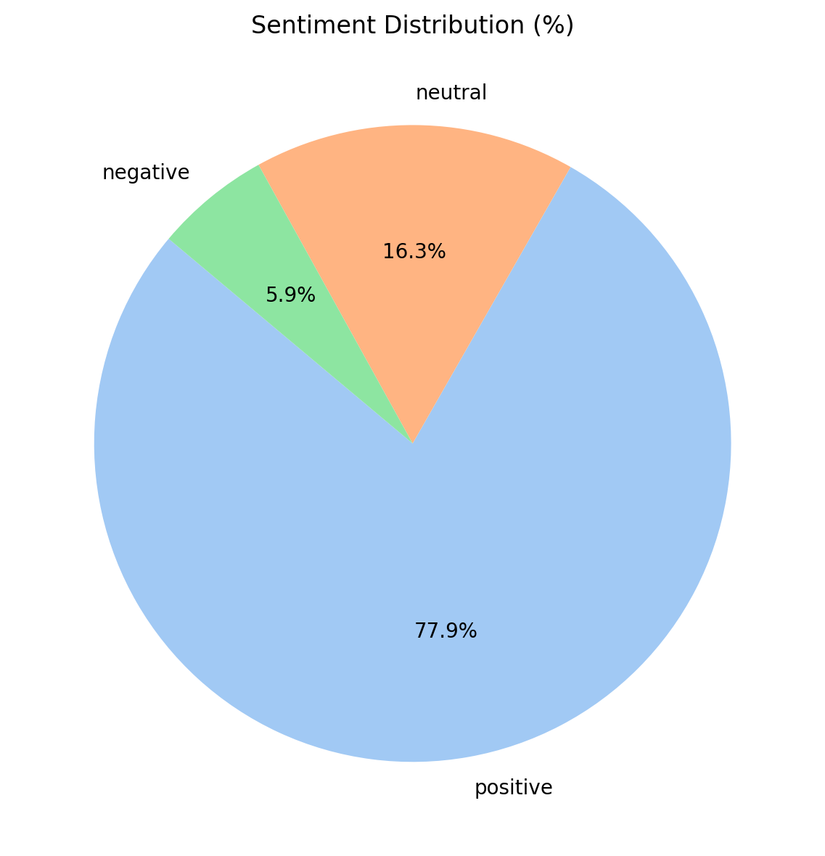
Audience Reception
Notes:
And it worked!
Overwhelmingly positive reception

Slide 7
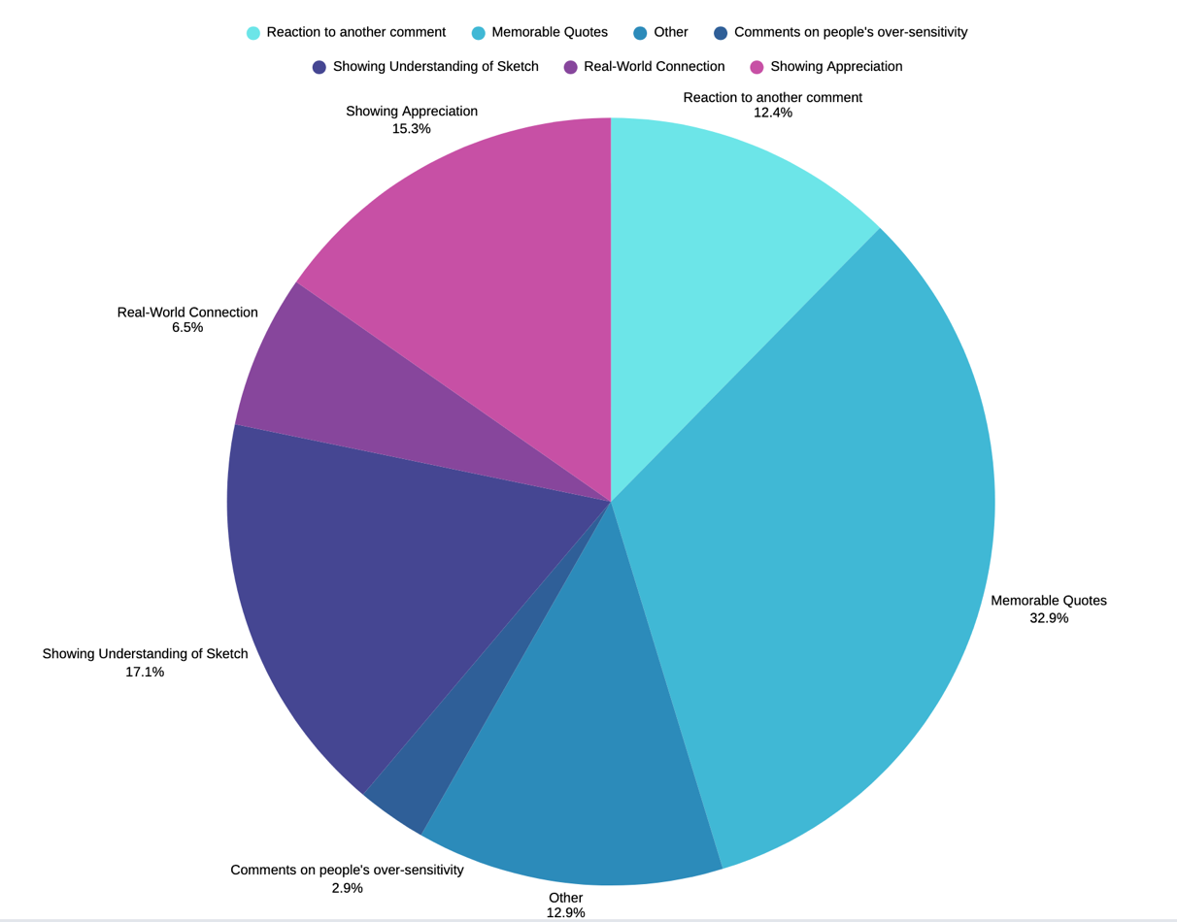
Audience Reception
Notes:
More importantly
Viewers drew real world connections from the sketch
Most significant, viewers drew parallels to modern job interviews.

Slide 8
REACTANCE THEORY IN ACTION
Notes:
This is reactance theory in action
Sketch didn’t tell viewers that modern capitalism could be dehumanizing.
Viewers made the connection themselves, in their own words, without defensive resistance.
Proves the effectiveness of indirect activism

Slide 9

Effective Distribution Channel
Notes:
Great content nothing without reach
Format an highly effective distribution channel
Using the STEPPS Framework
An explanation why Auctionblock achieved 70+ million views
What truly matters is what happens after the content spreads

Slide 10
Why Does This Matter
Views
Discourse
Change
Notes:
Virality sparked genuine critical public discourse
Reddit host debates about:
Whether satire dismantles stereotypes or inadvertently reinforces them
Educational discussions about race, power, and representation.
Conversations enhance critical thinking and collective understanding
moving viewers from Passive consumption to active reflection → virality to actual social change

Slide 11
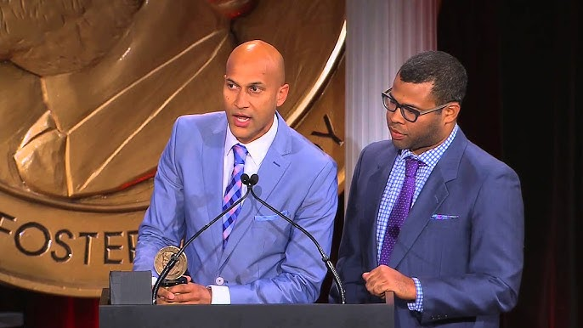
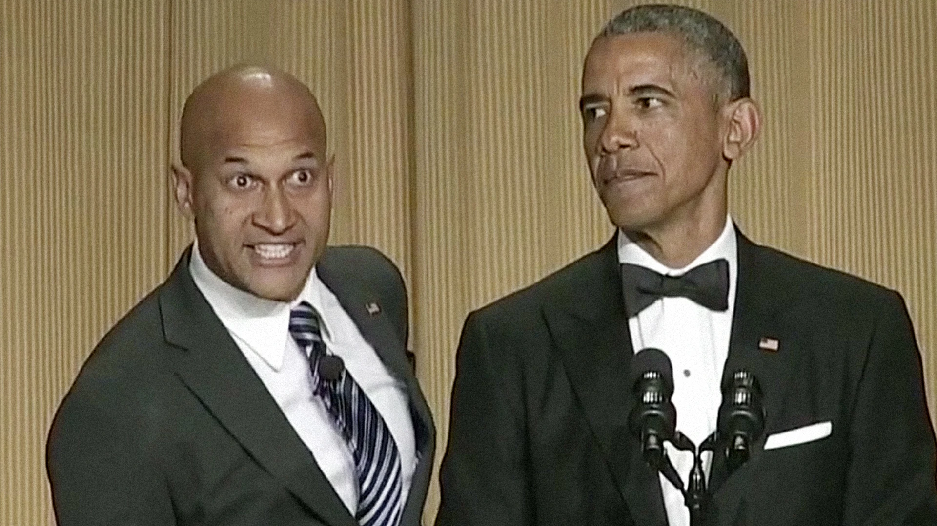
Validation At The Highest Levels
Peabody Award
Anger Translator with Obama
Notes:
Even works at the highest echelons of power.
Peabody Award in 2014:
Prestigious reward given to influencial social commentators
Most remarkably:
President Obama validated their satire by participating in Anger Translator routine at the White House Correspondents’ Dinner
Praised by critics, embraced by the very power structures they satirized.
Political Satire is not just entertainment: its recognized as legitimate social commentary, even by the highest powers in the world
In our polarized digital age, Key & Peele have shown us that the most effective activism may not be the most direct. By lowering defenses, sparking discourse, and achieving cultural recognition, political satire has emerged as a vital tool for 21st-century social change. Sometimes, the best way to make people think isn't to tell them what to think—it's to make them laugh and let them reach the conclusions themselves.

